Slide 1
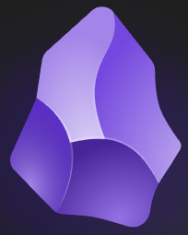
Obsidian
Your Personal Knowledge Base
The Tip Of The Iceberg
This is all Kurt’s fault
Don’t be underwhelmed
How we learn
Building Habits and Journaling
Obsidian at your command - Plugins
Taking Daily Notes and Research Notes
Looking Good
Multi-Device use
Guest speakers and their experiences
Feel free to install and play as we are going through the application
Ask questions
Resources: Github page
obsidian.md

Slide 2
All Kurt’s Fault
My goal today is to stir interest and curiosity in your own learning and growth
History
Developed by Shida Li and Erica Xu while quarantining during COVID-19 pandemic
Students at the University of Waterloo they built Obsidian utilizing Electron
What is Electron? Free and Open-Source framework maintained by OpenJS
Windows, Linux, macOS, and mobile Android and iOS
Customized using plugins and themes
obsidian.md

Slide 3
Don’t be underwhelmed
How Kurt captured my attention
My use of a notebook and planner – My Playbook
Have been looking for some time for an electronic replacement that works for me
- Notion
- Evernote
- Notability
- Others….
All great applications, but I was just not satisfied and kept going back to my paper method
Obsidian didn’t click right away, it has taken an investment to learn and make it work for me
But once it did, it has been exactly what I was looking for, and everything is finally in one place…. My Obsidian Vault
Your vault does not have to be perfect, MD files are extremely easy to use
They will evolve over time and you won’t lose your data
NO PROPIETARY FORMAT!!
Creating your first Vault and first page
obsidian.md

Slide 4
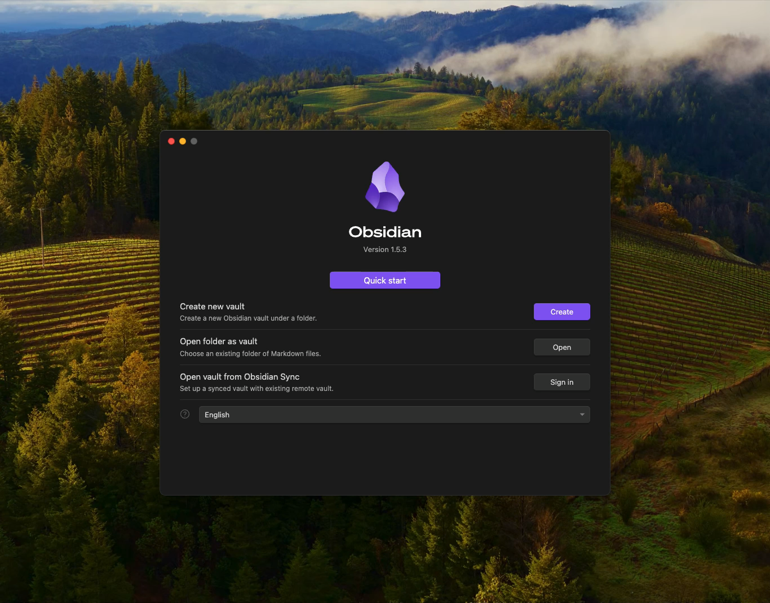
obsidian.md

Slide 5
Live Demo Of Created Base Vault
Read View / Edit View
Linking
Embedded Linking
See how this is underwhelming at first glance
obsidian.md

Slide 6

How we learn
We have a web of thoughts
Connecting those thoughts and keeping that information together is a challenge
Obsidian allows us to create links between thoughts
Produces a graph of knowledge
Queries to pull data together
Zettelkasten
Fleeting Notes – Quick thoughts, to dos
Reference Notes – Capture Other People's Work
Literature Notes – Note in your own words about a reference
Writing what you want out of it is key
Permanent Notes – 1 note 1 idea, short and concise
obsidian.md

Slide 7

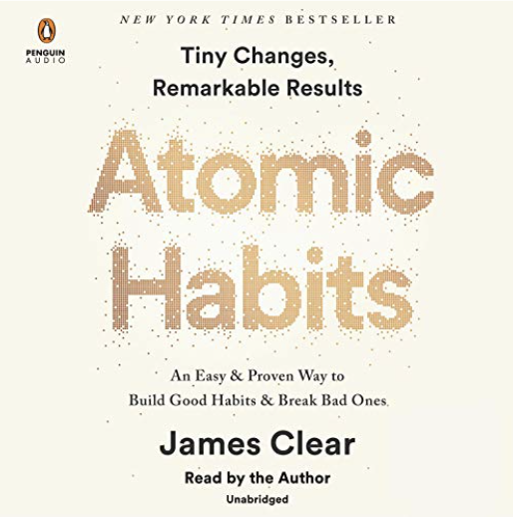
Building Habits and Journaling
Daily tracking
Journaling
Calendar and Templates
obsidian.md

Slide 8
Obsidian is at your command
Briefly had seen these with the previous example
Plugins
Darn, near 1,200 plugins
What defines a good plugin
make things faster and automate
adds relevant functionality
make things easier
Templates, Checklist, Dataview, Templater, Calendar
Cool tip: Embedding YouTube video into a note
How I Used O'Reilly Videos I Pulled
Have not tried yet:
- Amazon Kindle Highlights
- Book Search Plugin
- Note Refactoring
Each vault has the plugins contained in the vault
obsidian.md

Slide 9
Taking Daily Notes
Periodic Notes - Daily, Weekly, Month, Yearly
Cool tip: Embedding YouTube video
O'Reilly Videos Embedded
obsidian.md

Slide 10
Canvas
I have limited use of this right now
Some cool plugins and uses seen on YouTube, Just not enough time in the day ☺
4 Things To Add to a Canvas
Notes
Cards
Media
External Links
What you do in the Canvas does not reflect in the Vault
Such as linking two notes in the Canvas
Cards only live in the Canvas
Cards can become Notes
obsidian.md

Slide 11
Looking Good
How to change the visual aspects
Creating your own
Themes are contained in each Vault like plugins
obsidian.md

Slide 12
Multi-Device Support
Yes, that is supported!!
Apple iCloud with GIT
iOS Obsidian, enable iCloud
Create a vault
Delete all files in the Obsidian directory created (hidden files as well)
Init Obsidian Directory with GIT
Create Vault with iOS Obsidian
Connect MacOS or other iOS devices to the Vault
Sync happens with iCloud files
Use GIT as normal
Apple iCloud
On the iOS version
Create a vault
Connect to the cloud vault with the MacOS Obsidian
These are now synced
Connect any other iOS or MacOS
Windows and Android
Pay Synching Service
obsidian.md

Slide 13
Guest Speakers
Kurt Wendling
David Lowrey
Alex White
obsidian.md

Slide 14
Resources To Spark Your Curiosity
Github:
https://github.com/Jeff-ADDev/ObsidianExamples
Feel free to use this to share your experience and setup
obsidian.md

